Slide 1
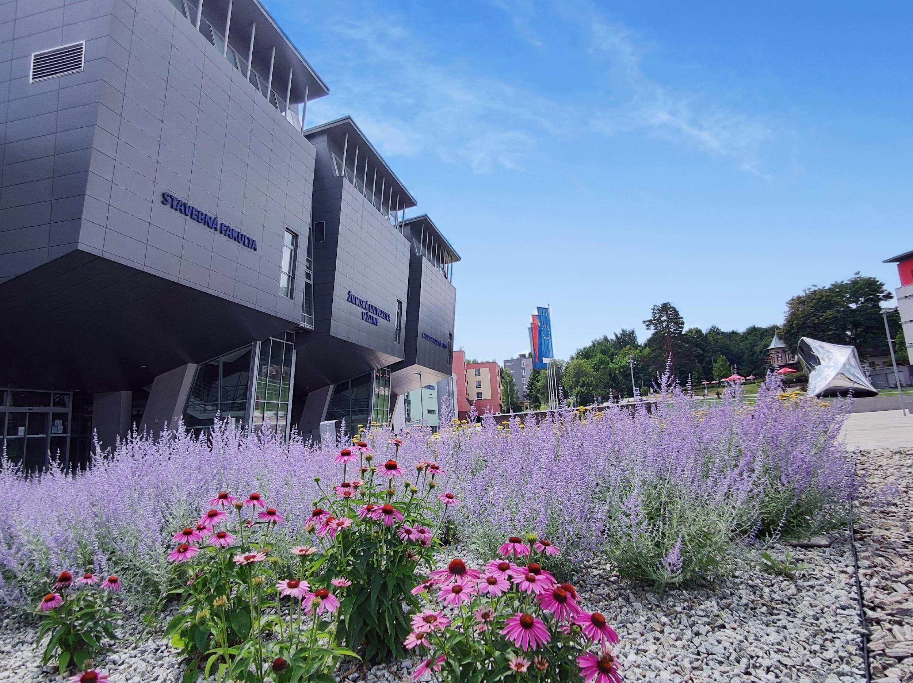
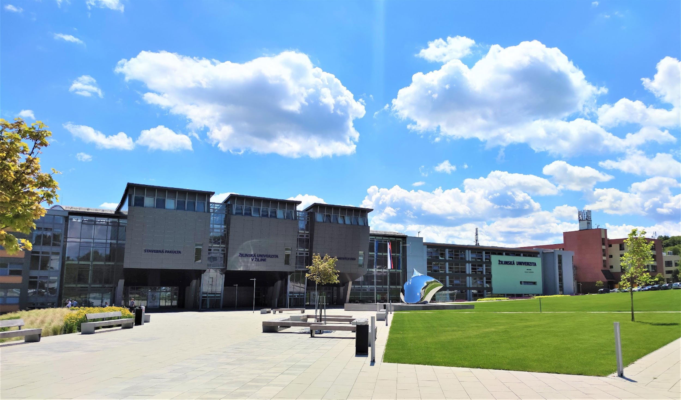
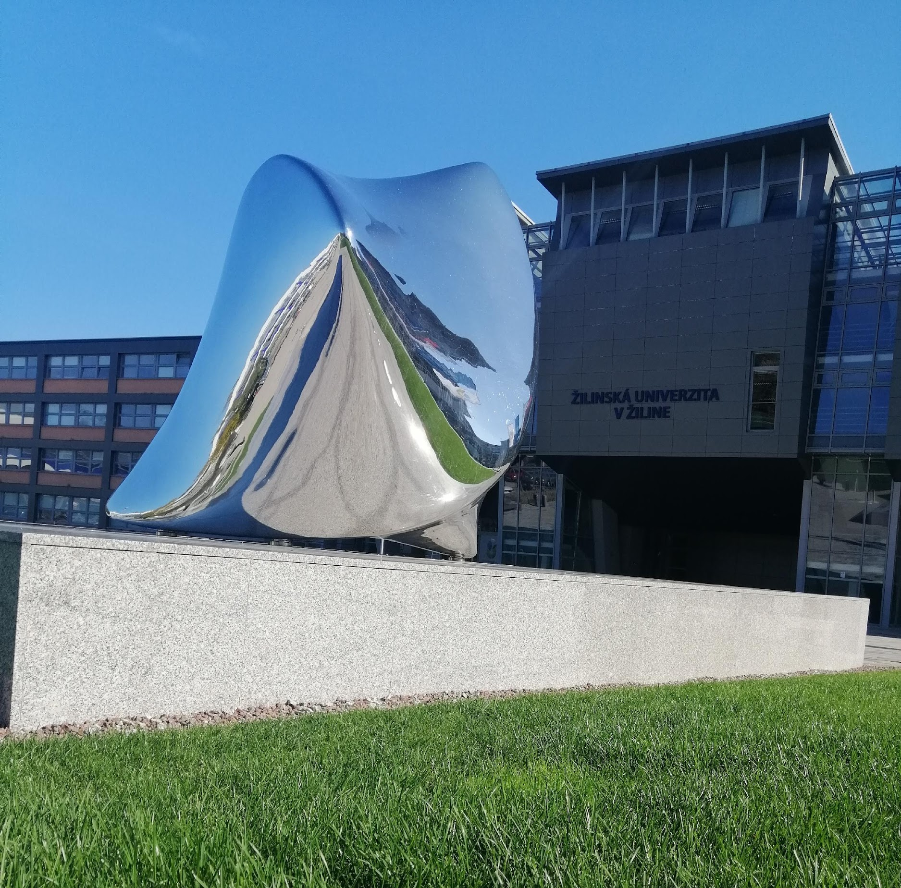
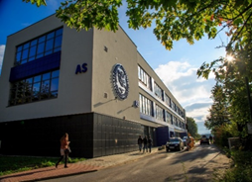

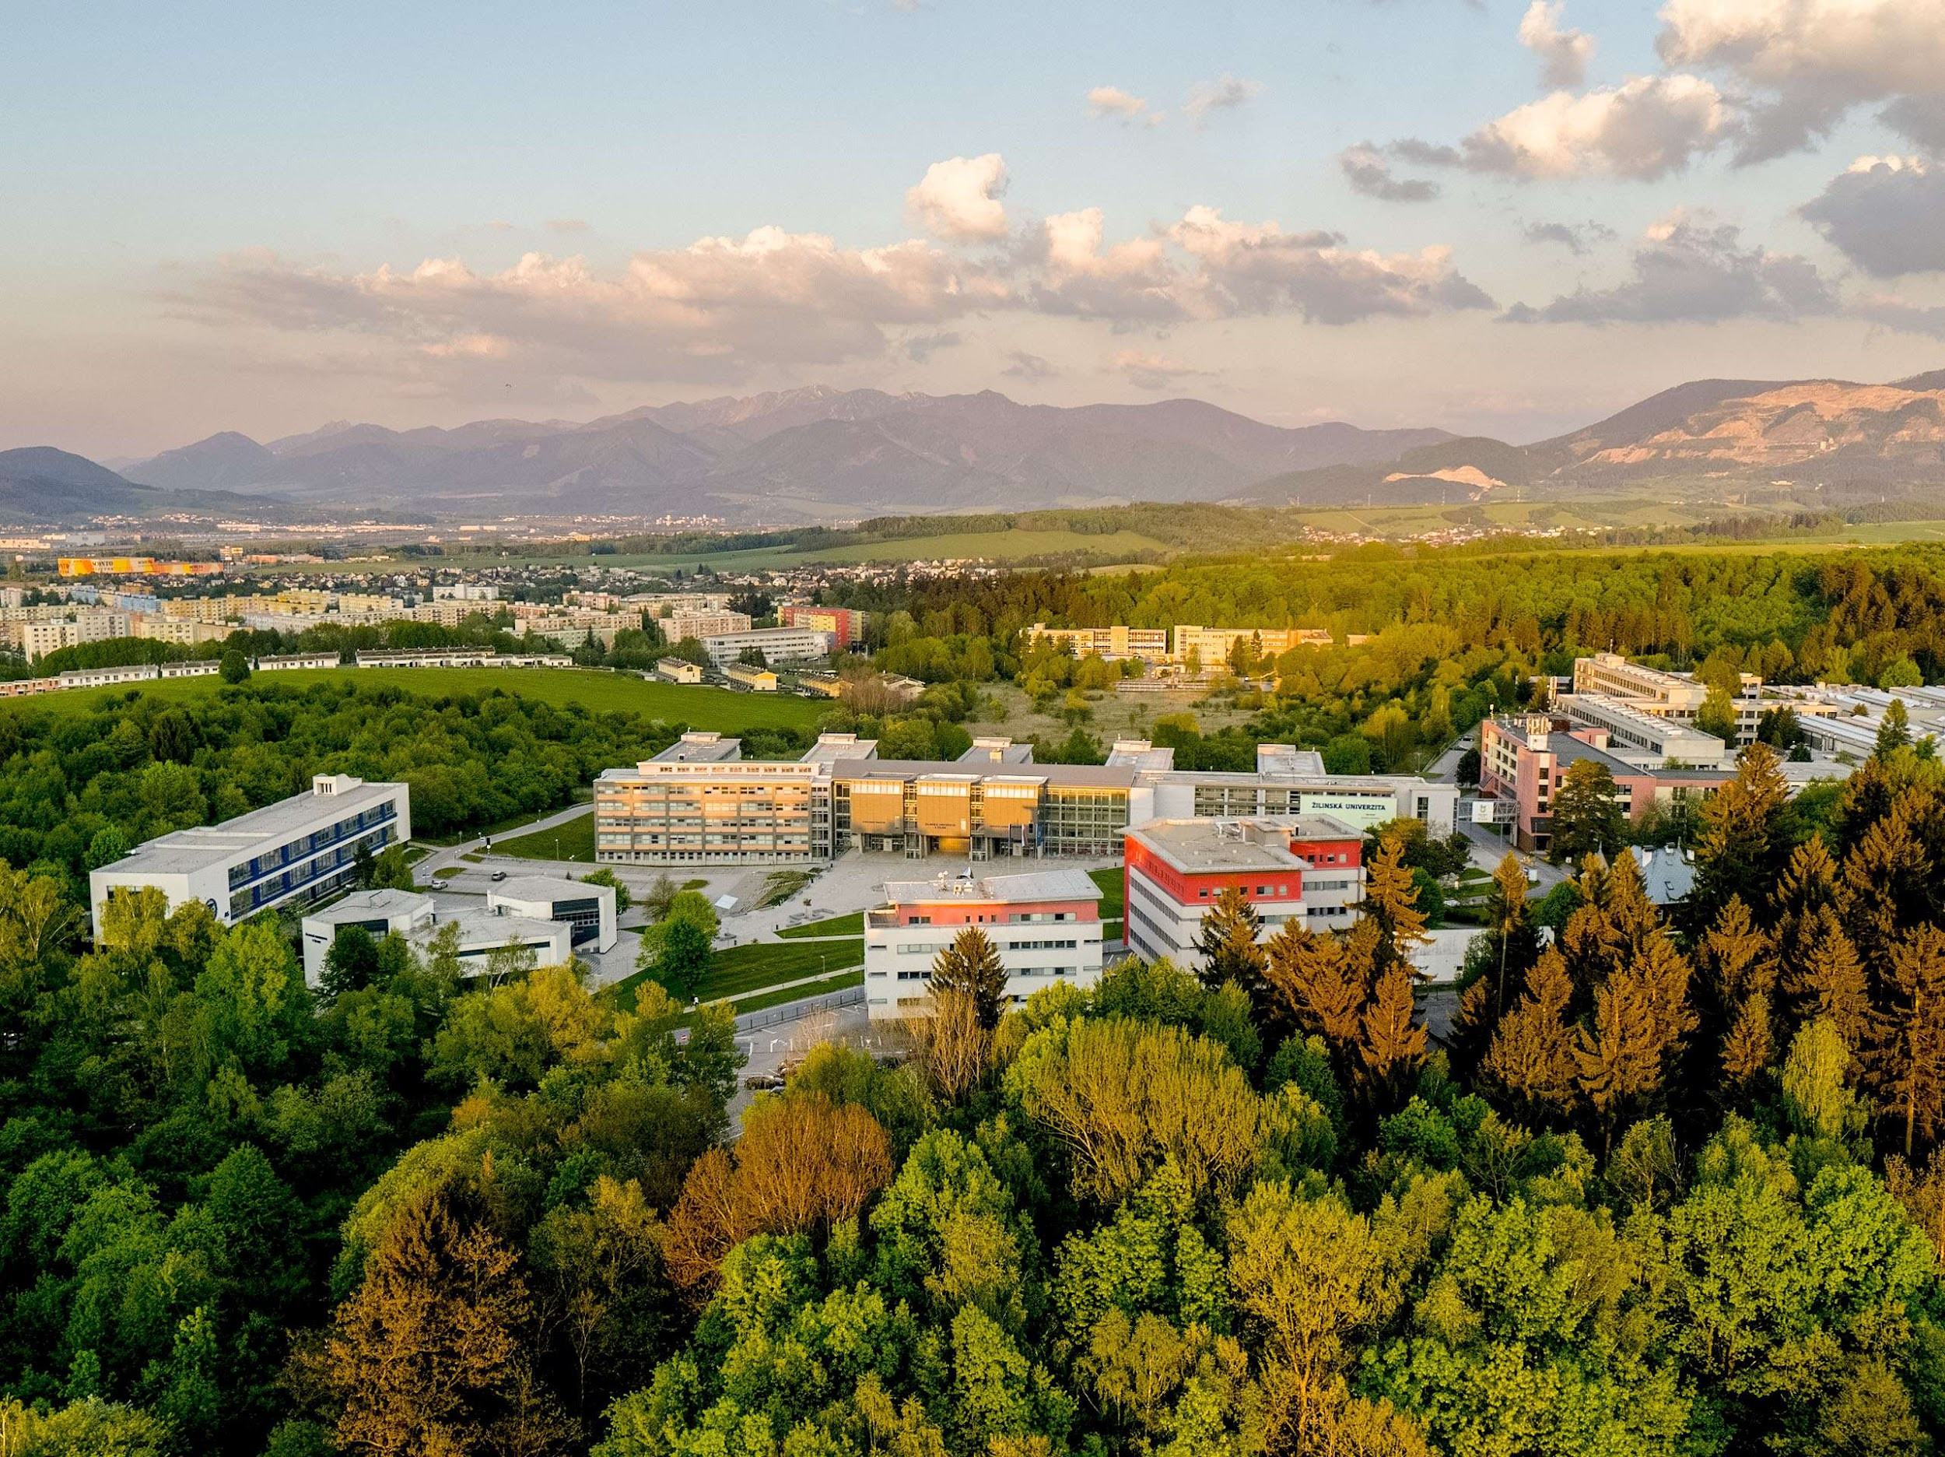

Slide 2
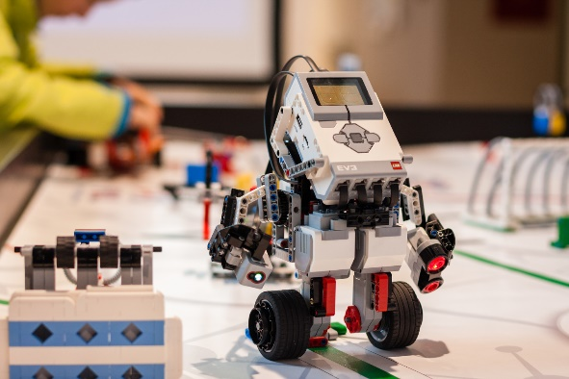
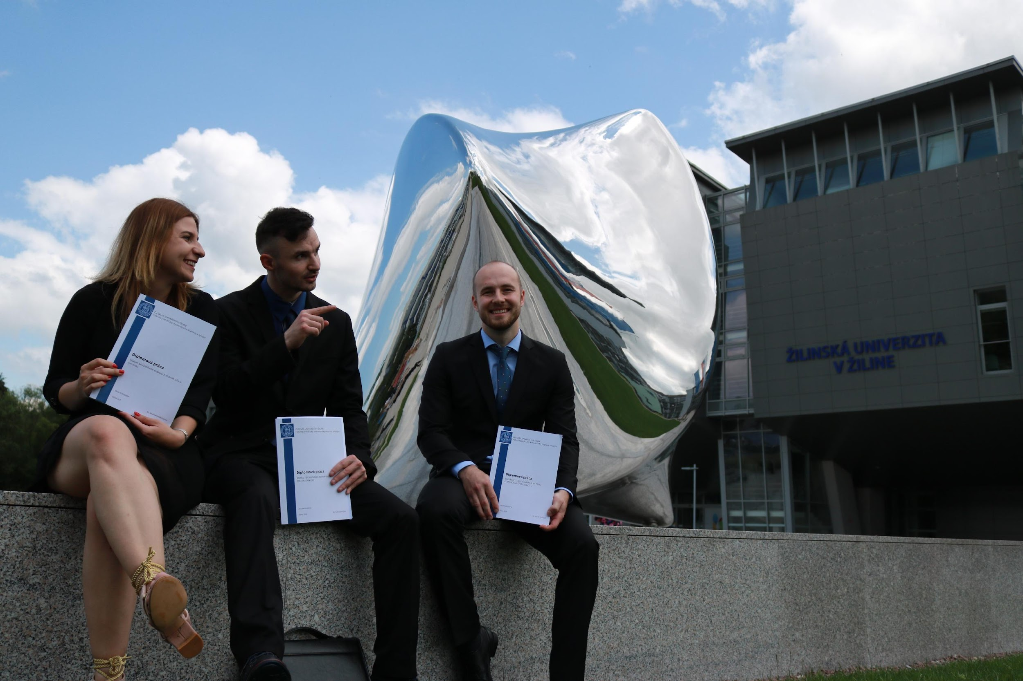

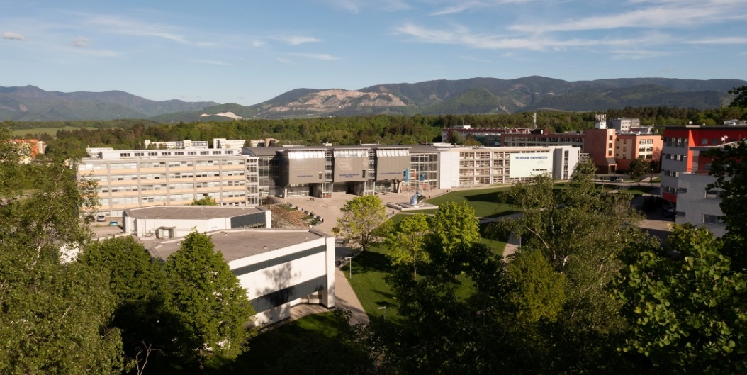
TOP AND UNIQUE
One of the top Slovak universities
A unique modern campus unique in Slovakia
Top study programs
State-of-the-art equipment and technology
at the university
Possibility of study and internship abroad
Cooperation with successful companies already during studies

Slide 3

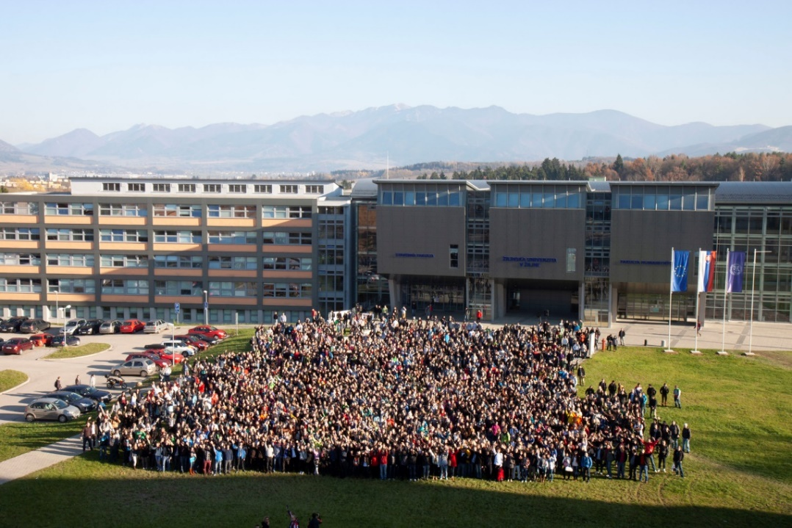
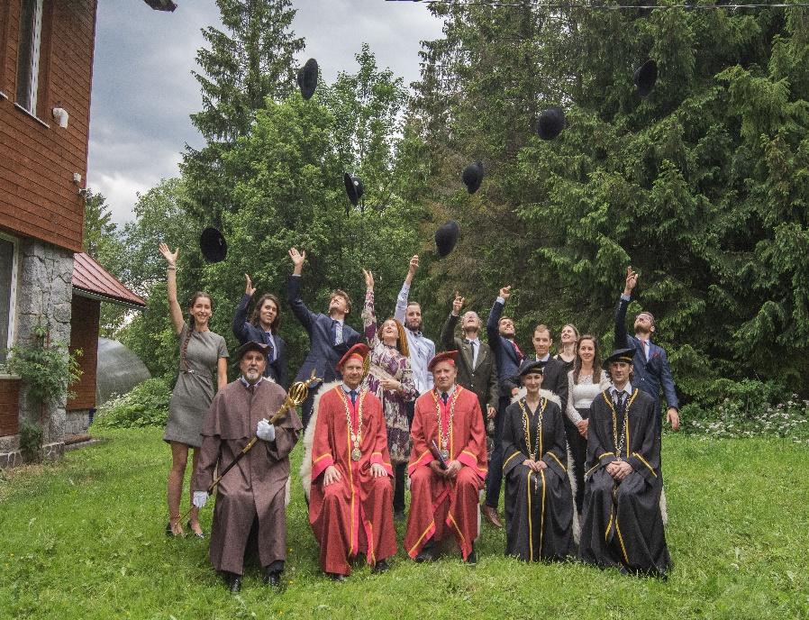
CURRENT NUMBERS
91.657 successful graduates
169 study programs
7418 students
1500 employees, 650 teachers, including 93 professors

Slide 4










RANKINGS UNIZA
UNIZA on the 1st shared place in Slovakia- according to THE Ranking​- World University ranking 2024
in TOP 3 among universities in Slovakia - QS Ranking 2025​
in TOP 3 – ranking of universities according to Profesia.sk​ interest of employers in Slovakia in graduates​
UNIZA among the TOP 4 in Slovakia in Green Metric 2024
UNIZA among the TOP 5 universities in Slovakia - SCIMAGO Institutions Rankings 2024

Slide 5












UNIVERSITY PROFILE
Transport
Engineering
Electrical engineering
Construction and Construction Industry
Information Technologies
Multimedia and Digital Technologies
Postal Services, Logistics and Forwarding
Economics, Management and Electronic Commerce
Safety and Security
Education and training
Nature protection
Mediamatics

Slide 6


UNIVERSITY PROFILE
Transport Operations (Road and Urban, Railway, Water, Air)
Transport Roads and Engineering
Transport Routes
Postal Services
Electrical Engineering
Telecommunications
Informatics
Information and Communication Technologies
Management and Marketing
Applied Mathematics
Mechanical Engineering
Materials and Technologies, Robotics, Machines
and Equipment Design, Energies
Civil Engineering
Crisis Management
Security Management
Civil Security
Fire Engineering
Forensic Engineering
Teaching of Academic Subjects
Library and Information Sciences
High Mountain Biology

Slide 7
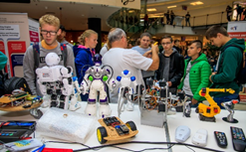
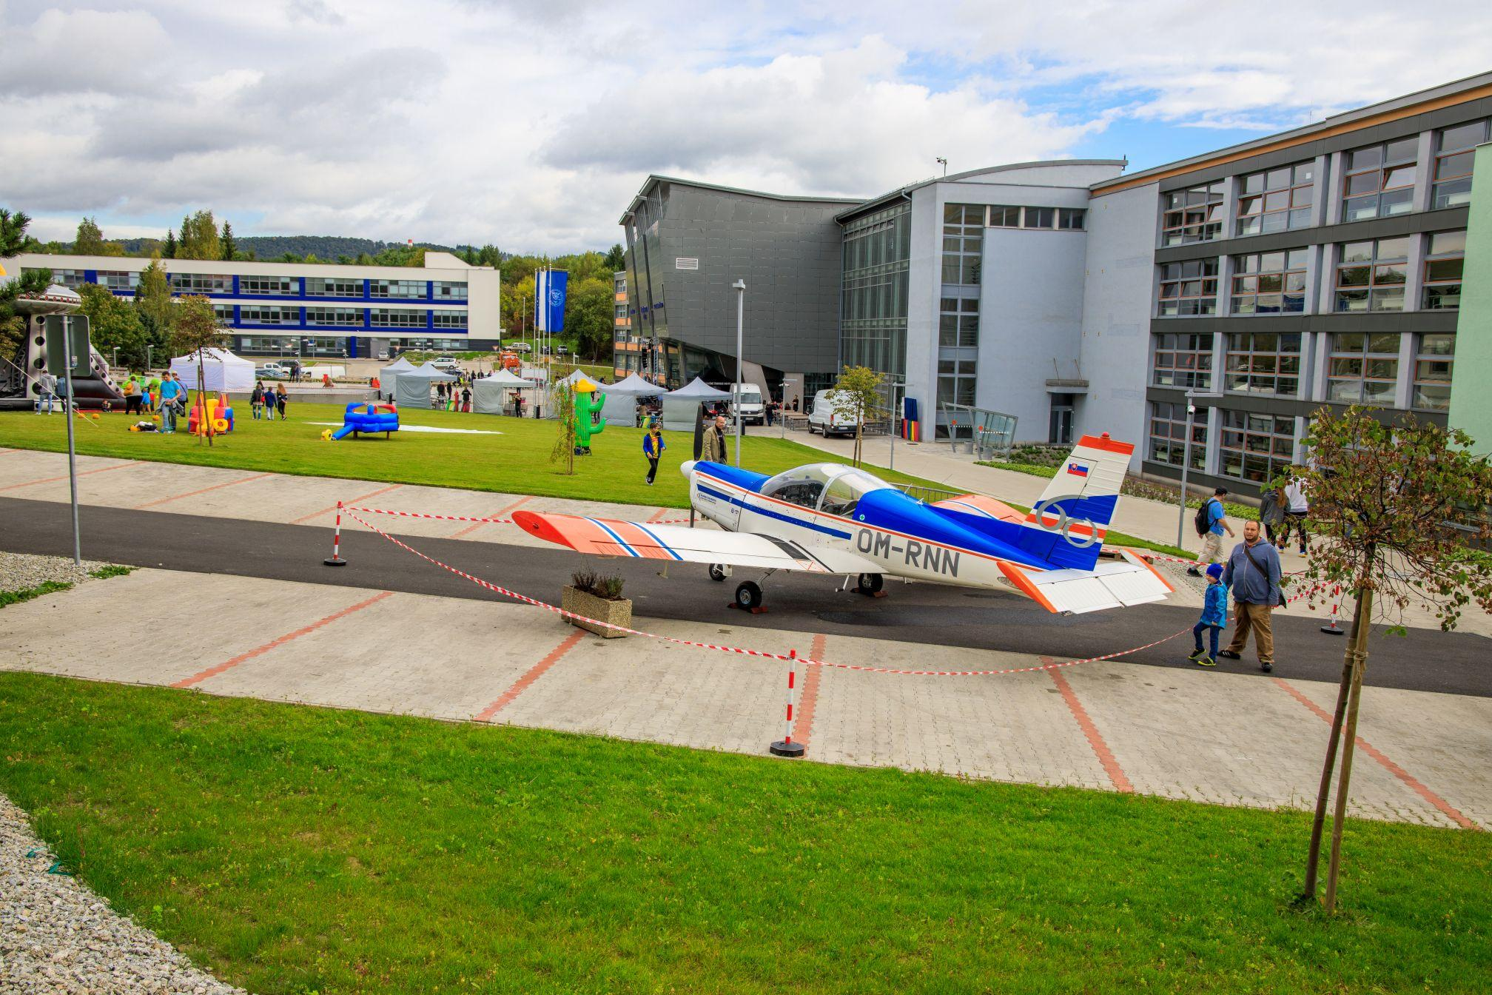
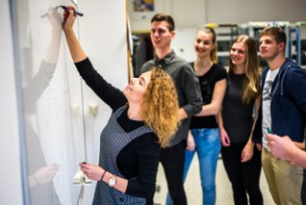
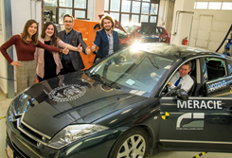
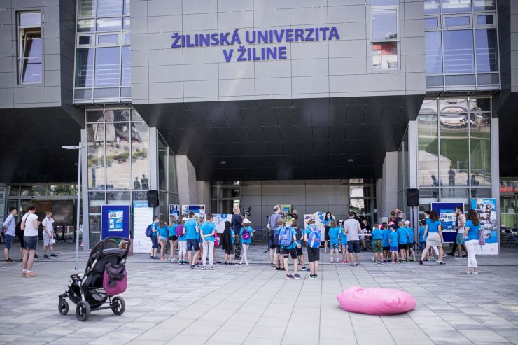
STUDY
Study programmes in all 3 levels of degree are offered:
Bachelor study programme (3 to 4 years)
Master study programme (2 to 3 years)
PhD study programme (3 to 5 years)
Study forms: full-time and part-time

Slide 8
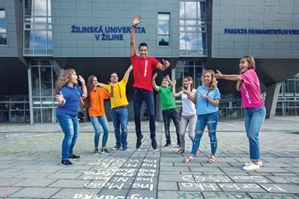








7 FACULTIES
Faculty of Operation and Economics of Transport and Communications
Faculty of Mechanical Engineering
Faculty of Electrical Engineering and Information Technology
Faculty of Civil Engineering
Faculty of Security Engineering
Faculty of Management Science and
Informatics
Faculty of Humanities
Institute of High Mountain Biology

Slide 9


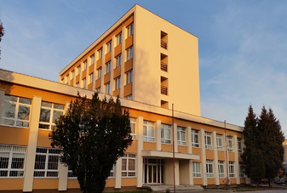

FACULTY OF SECURITY ENGINEERING
https://www.fbi.uniza.sk/en/
Bachelor´s degree study programmes SK | EN
Security Management
Crisis Management
Rescue Services
Department of Security and Safety Research
Notes:
Dept. of Crisis Management
Dept. of Fire Engineering
Dept. of Security Management
Dept. of Security and Safety Research

Slide 10
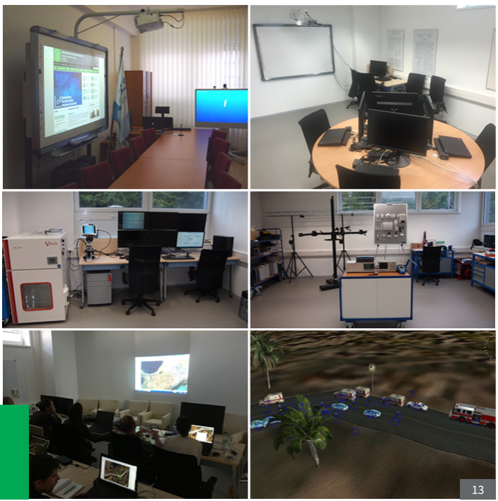

Slide 11
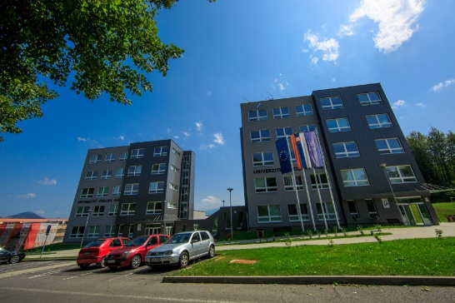
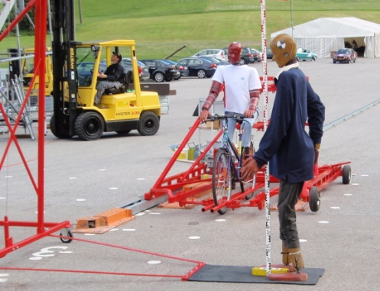
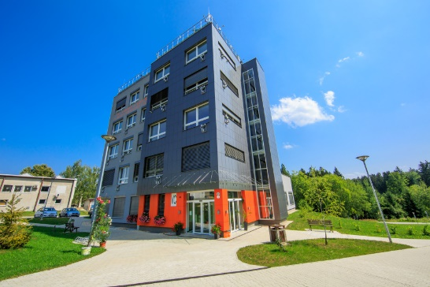
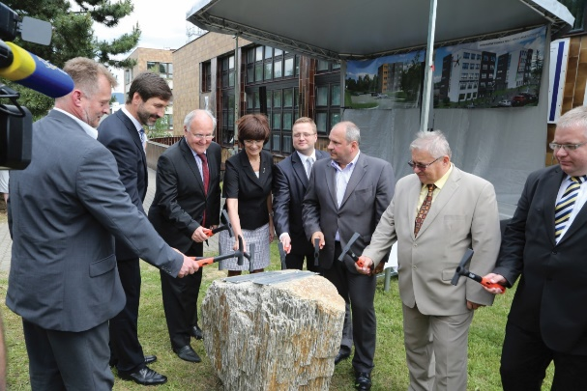
INSTITUTES
University Science Park
Research Centre
Institute of Lifelong Education
Institute of Forensic Research and Education
Institute of Physical Education
Institute of Competitiveness and Innovations
Aviation Training and Educational Centre

Slide 12

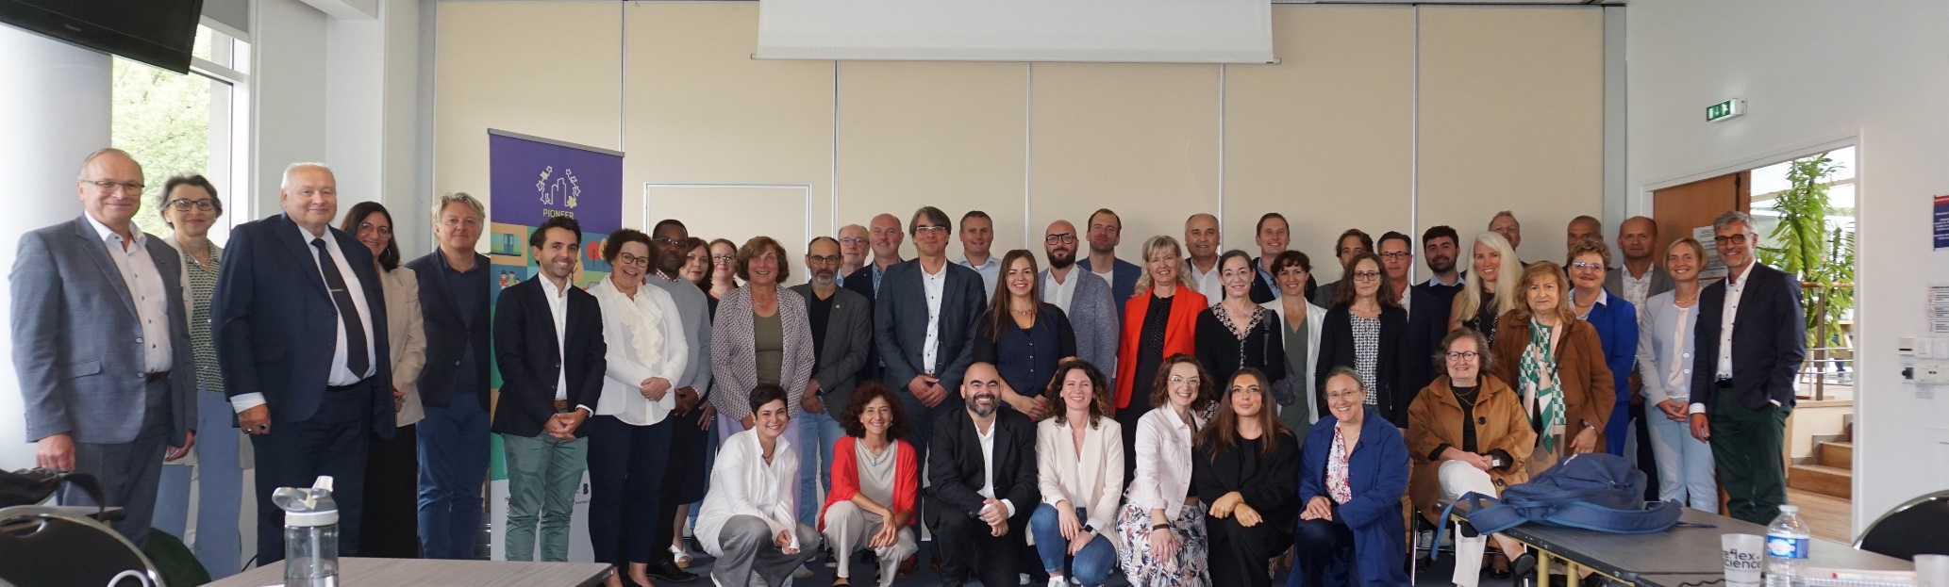
PIONEER ALLIANCE
PIONEER brings together 10 universities, over 130,000 students and 17,000 faculty and staff across Europe. Our alliance of 10 impact-driven universities is shaped around our shared expertise in cities and ecosystem co-creation.
PIONEER website PIONEER LinkedIn

Slide 13

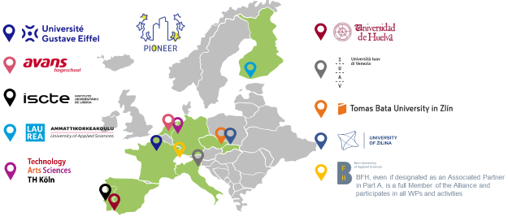
PIONEER ALLIANCE
PIONEER is built on the ongoing collaboration between its members, both in terms of student exchanges and European research and innovation projects, and on desire to take this collaboration further and develop activities that we could not undertake on our own.

Slide 14











































ECOSYSTEM UNIZA
University of Gustave Eiffel
University of California, Berkeley
Ningbo University of Technology
International
Regional partners
University Workplaces
INOVIA Innovation center
ŽILINA SELF-GOVERNING REGION
CITY OF ŽILINA
Strategic partners

Slide 15
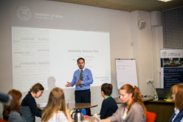
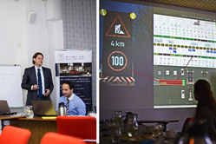
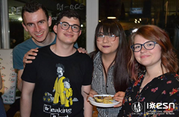
INTERNATIONAL COOPERATION
Bilateral agreements (more than 150):
Europe (Austria, Belgium, the Czech Republic, Denmark, France, Germany, Greece, Hungary, Italy, Netherlands, Poland, Portugal, Switzerland, Spain, the UK,...)
Strategic Partner: University of Gustave Eiffel, Paris, France.
Asia (China, Japan)
Strategic Partner: Ningbo University of Technology
America (USA, Mexico, Brazil).
Strategic Partner: UC Berkeley, Berkeley Engineering, USA.

Slide 16






INTERNATIONAL ORGANIZATIONS
Magna Charta Observatory
EUA
FEHRL
ECTRI
EARPA
SDT
EUROSIS
VUA
PSCE
UITP
EUF

Slide 17
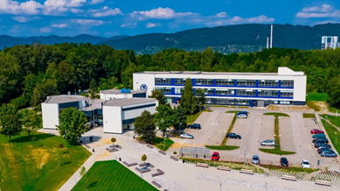
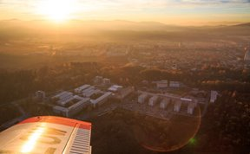
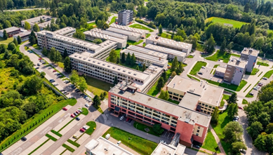
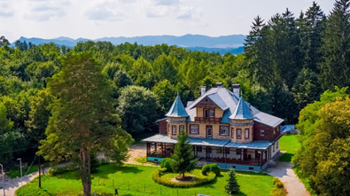
MODERN CAMPUS

Slide 18



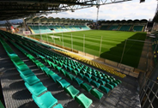
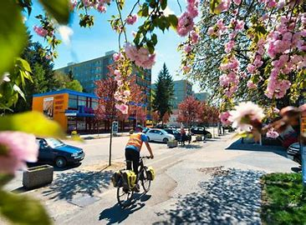

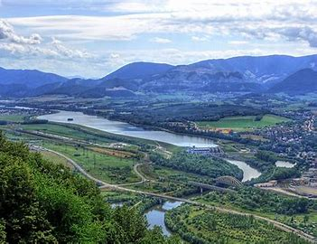
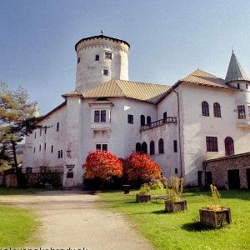
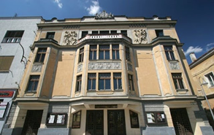
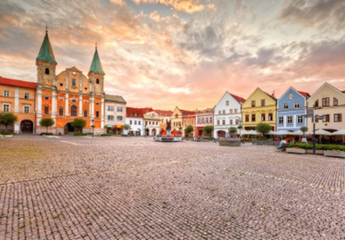
ŽILINA

Slide 19




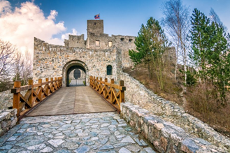

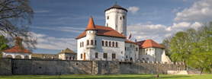



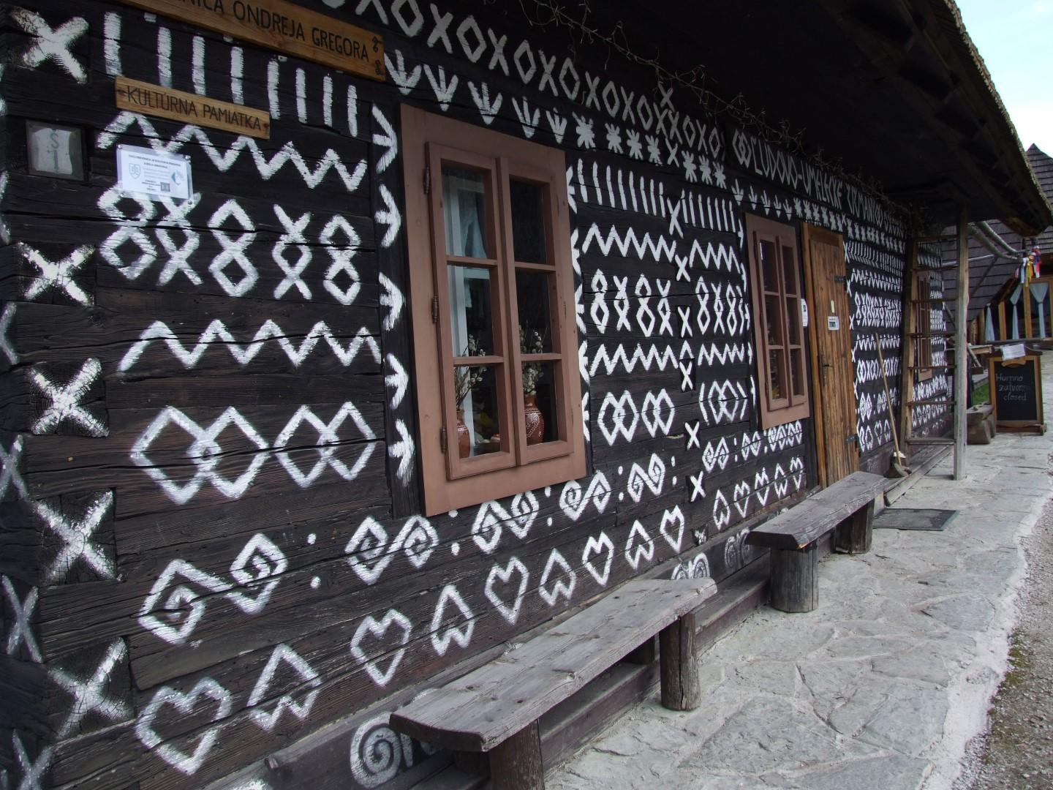
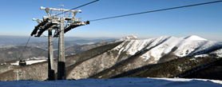
SURROUNDINGS

Slide 20
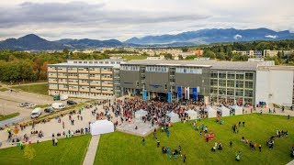
VIDEO

Slide 21

